Slide 1

Dynamic Effects of Product Rating and Observational Learning on the Demand for Supplementary Products
By: Meisam Hejazinia
Advisor: Dr. Norris Bruce
The University of Texas at Dallas
utdallas.edu

Slide 2

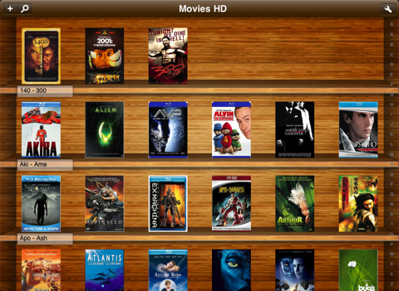
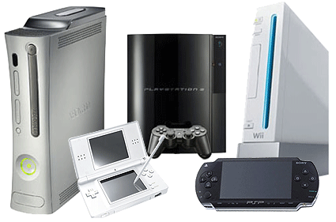


Supplementary products

Slide 3
Motivation: Product Review as source of information to purchase a product
Online consumer reviews are the second most trusted source of brand information and messaging, with 70 percent of global consumers surveyed online indicating they trust messages on this platform, an increase of 15 percent in four years. [www.nielsen.com, 2012]
While it’s true that hitting the “Like” or “Retweet” button doesn’t require as much effort or intellectual thought as say, writing a product review or having a real-life conversation, these social actions do have the potential to drive a company’s success.
[spinnakr.com, Apr 24th, 2013]
Approximately 72% of consumers surveyed said that they trust online reviews as much as personal recommendations, while 52% said that positive online reviews make them more likely to use a local business. [searchengineland.com, Mar 12, 2012]

Slide 4
Current research’s position
 | Static | Dynamic
Effect of Average Rating on Sales and predictor of Revenue and observational learning | Chavalier and Mayzlin (2006) Chintagunta et al. (2010) Dellarocas et al. (2007) Chen et al. (2010) | This study
Effect of Variance of Rating on Sales | Clemons et al. (2006) Monic Sun (2012)
Effect of Rating Environment, social dynamic and Self Selection | Li and Hitt (2007), Brandes et al. (2013) Gao et al. (2006) | Moe and Schweidel (2012) Moe and Trusov (2011) Godes and Silva (2012)
Firm’s Best response | Chen and Xie (2005), Chen and Xie (2008), Mayzlin (2006) ,Dellarocas (2006), Mayzlin et al. (2012) | Jiang and Chen (2007)

Slide 5
Literature on product review
Empirical Studies
Godes and Mayzlin (2004) | Dispersion of conversations across communities can explain dynamic of TV ratings
Zhao et al. (2012) | Consumers learn more about an experience good from online consumer product reviews than their own experience of product category
Moe and Trusov (2011) | The impact of social dynamics in the rating environment on both sales and subsequent rating behavior.
Moe and Schweidel (2012) | Individual’s decision to provide a product rating is subjected to selection effects, and adjustment effect. Positive ratings environment increases positing incidence, yet negative rating environment discourage posting.
Godes and Silva (2012) | Residual average temporal pattern of product reviews is increasing, after controlling for calendar date. Consumer product ratings tend to plunge over time.
Zhu and Zhang (2010) | Consumer product ratings are more influential for less popular products
Gao et al. (2006) | Significant impact of public opinion on consumer product reviews
Chavalier and Mayzlin (2006) | Positive impact of average rating on sales, and higher impact of one-star reviews than five-star-reviews
Dellarocas et al. (2007) | Better predictability of diffusion model that incorporates consumer review for box office revenue data
Duan et al. (2008) | Insignificance of the impact of online user reviews on movies’ box office revenues after accounting for endogeneity
Liu (2006) | Aggregate and weekly box office revenue can significantly be explained by online word of mouth, especially at early weeks of movie release
Clemons et al. (2006) | Variance of ratings play significant role in determining which new products grow fastest in the market.
Chintagunta et al. (2010) | Valence rather than volume of consumer product reviews drive box office performance
Li and Hitt (2007), Brandes et al. (2013) | Online product reviews are subject to self-selection.
Ye et al. (2009) | Online consumer reviews have significant relationship with business performance of hotels.

Slide 6
Literature on Product Review
Theoretical Studies
Monic Sun (2012) | Informational role of variance of product rating on the product subsequent demand
Chen and Xie (2008) | Firm’s best response to consumer product reviews
Chen and Xie (2005) | Firm’s strategy to adapt consumer product reviews
Mayzlin (2006) ,Dellarocas (2006), Mayzlin et al. (2012) | Firm’s online manipulation of consumer product reviews
Awad and Etzion (2006) | Firms’ filtering of consumer product reviews
Jiang and Chen (2007) | Firm’s dynamic strategy to leverage consumer product review
Studies on observational learning
Chen et al. (2010) | Positive observational learning information significantly increases sales, whereas, negative observational learning information has no effect.
Bikhchandani et al. (1998, 2008) | Observational learning may lead to information cascade and herd behavior.
Bikhchandani and Sharma (2001) | Over view of theoretical and empirical research on herd behavior
Banerjee (1992) | Herd behavior leads to inefficient equilibrium.

Slide 7
Research Question
How product rating and observational learning affects the demand for supplementary products?
Whether there is any dynamic in the effects of product rating valence and observational learning on demand? Is there any heterogeneity in these effects?
Can we explain heterogeneity in terms of institutional characteristics such as market segment size and competition intensity? How does uncertainty moderate the effect of different processes?

Slide 8
Overview
Data
52 Fire fox Add-ons
Five years daily data (2008-2013)
Method
Dynamic Linear Model (Kalman Filter)
Bayesian hierarchical model (MCMC)
Results
Dynamic and diverse effect of Product Rating and Observational Learning (Bias if not account for)
Negative effect of uncertainty in product rating on observational learning
Effect segment size and competition intensity on carryover and effect of product rating

Slide 9
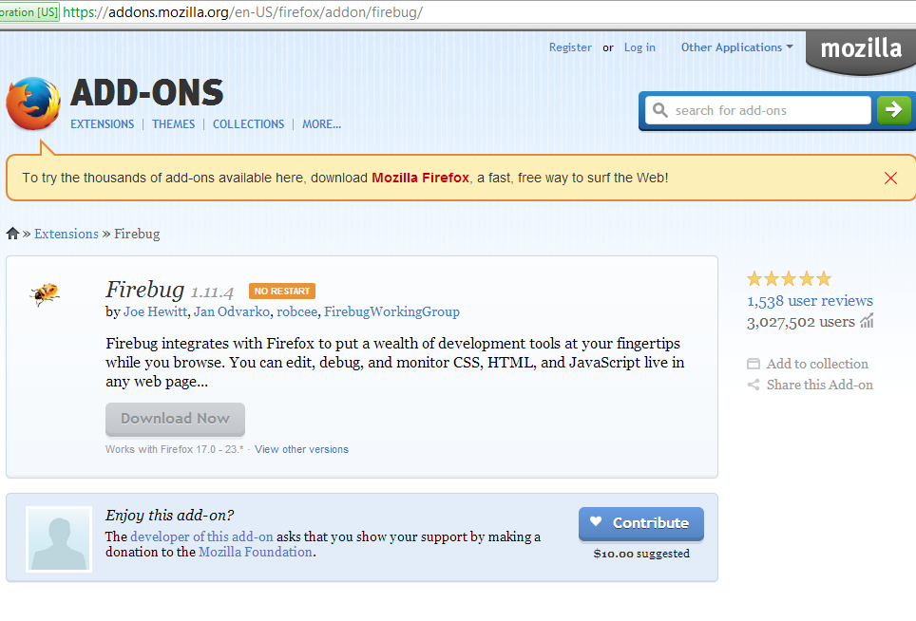
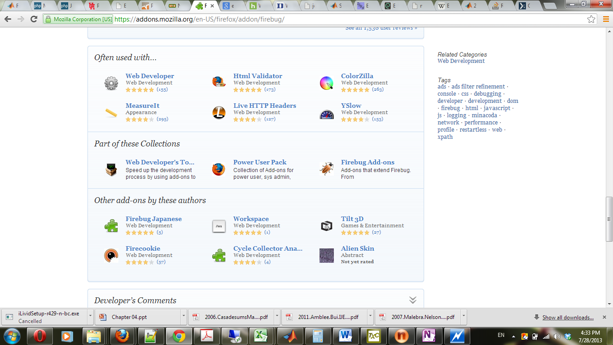
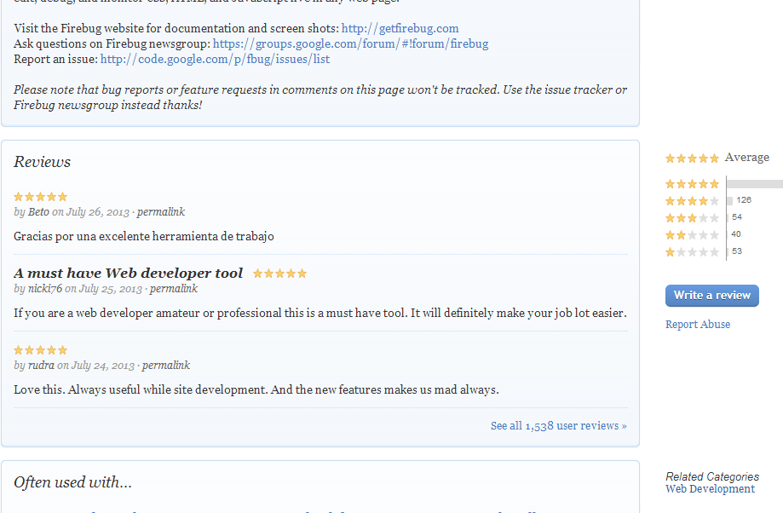

Slide 10
Basic Statistics
 | Mean | SD | Min | Max
Downloads (K) | 7.641 | 18.502 | 11.79 | 283.44
User Base Size (M) | 0.883 | 1.955 | 1.00E-06 | 16.97
Rating Valence Mean | 4.275 | 0.499 | 1 | 5
New Version of Product | 0.015 | 0.123 | 0 | 1
Product Category Search | 38.753 | 17.566 | 0 | 100
Share of Windows | 0.86 | 0.15 | 0.03 | 1
Number of Reviews | 382.64 | 584.93 | 2 | 3686
Variance of Rating | 1.46 | 0.76 | 0.48 | 4.2
Size of Developer Team | 1.32 | 0.72 | 1 | 4
Length of time series | 1321.9 | 456.6 | 260 | 1686

Slide 11
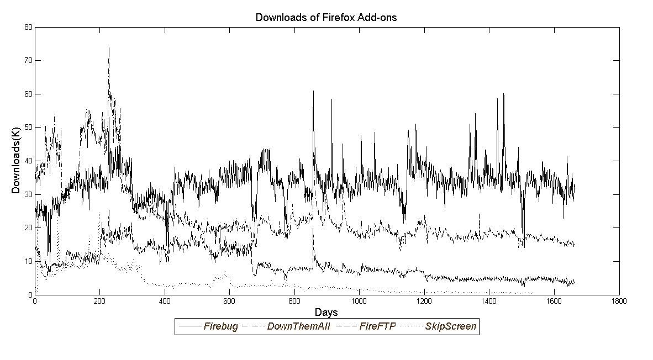
Data: Examples of Downloads Dynamic

Slide 12
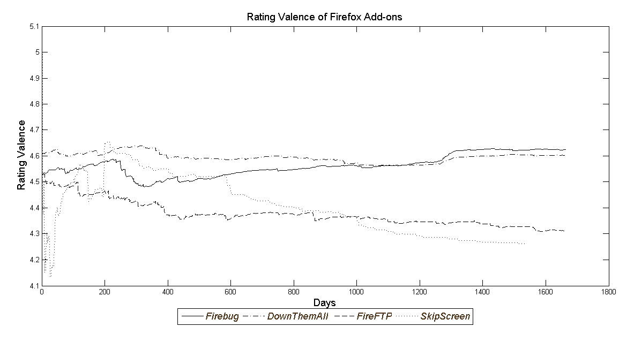
Data: Examples of Rating Valence dynamic

Slide 13
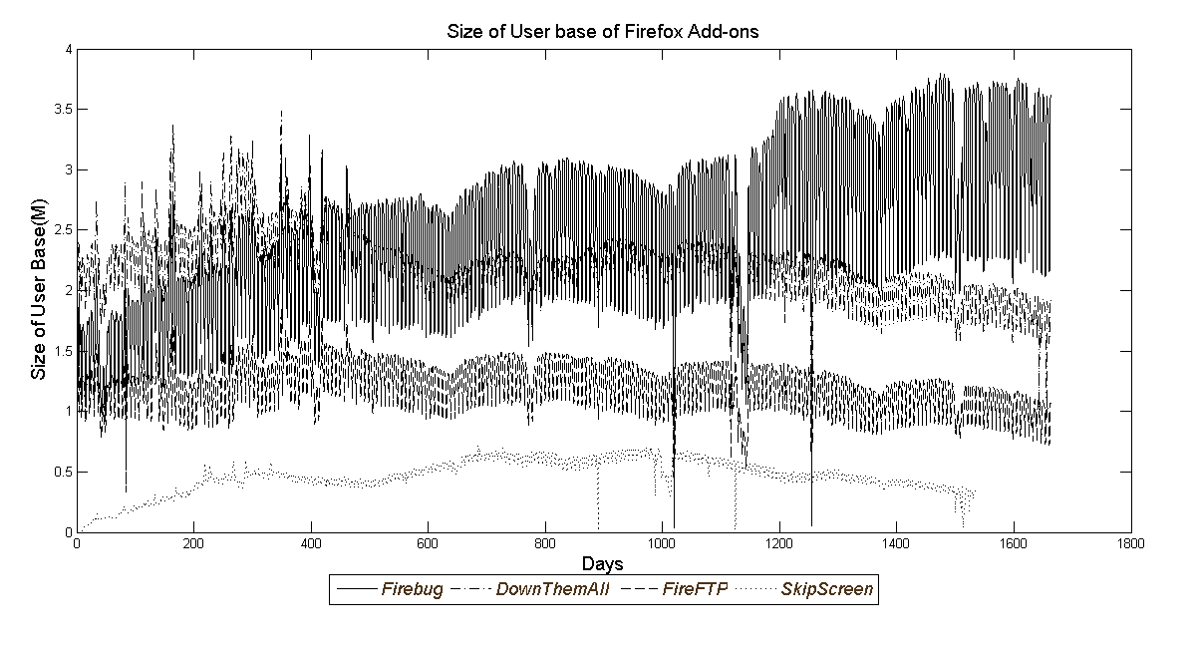
Data: Examples of User Base Size Dynamic

Slide 14
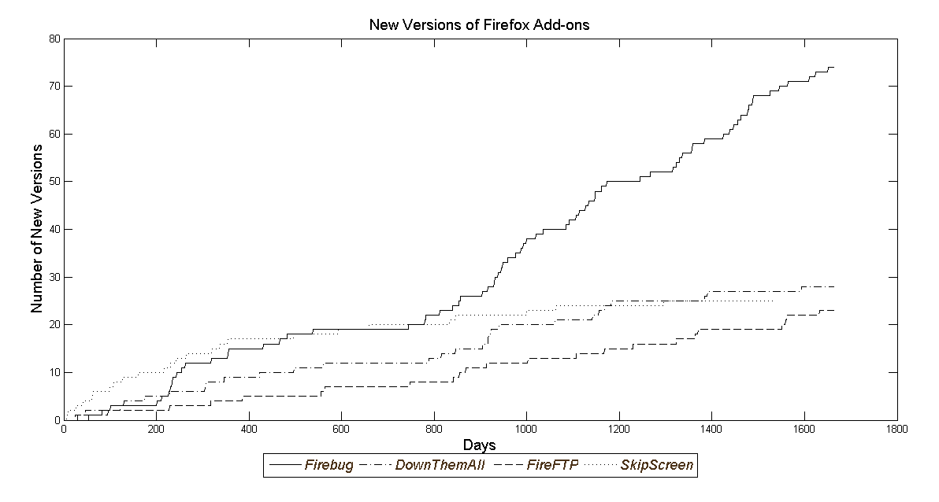
Data: Examples of New Version Dynamics

Slide 15
Model
:Add-on index
: Time index (ranging from 1 year to 5 year)
: download level of add-on i at day t
: Weekend Dummy
: Latent measure (captures attractiveness of download)
:Vector of consumers rating, user base size, New version dummy, product category search
: Vector of cross sectional product characteristics (such as Share of windows, variance of rating, Author team size, users of add-on used with)
(1)
(2)
(3)
Parameters to estimate

Slide 16
Estimation
FFBS for Each Add-on
Gibbs Sampler for each add-on
Gibbs Sampler for all add-on’s parameter

Slide 17
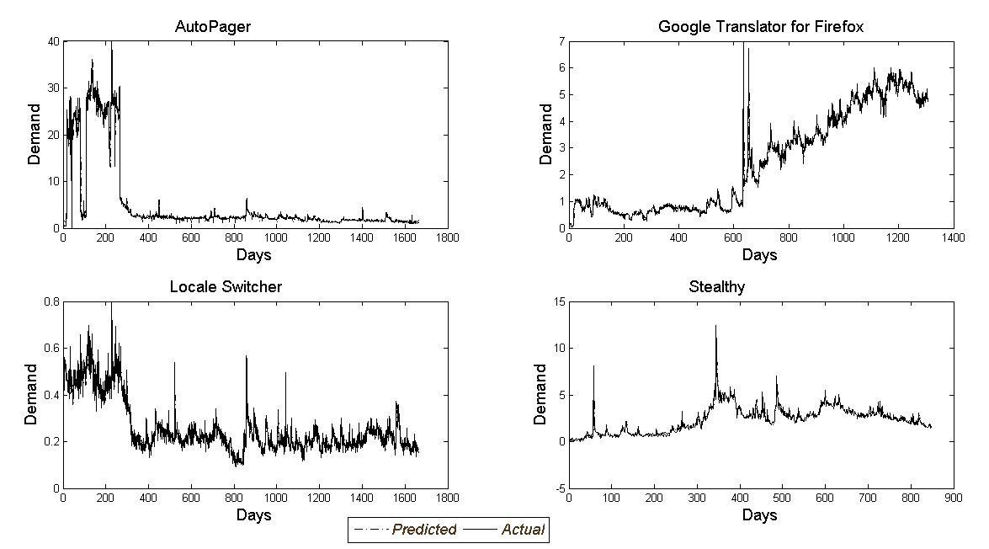
Model Performance: 1-Step Ahead Forecast

Slide 18
Model Performance: MAD and MSE
Example Add-on | Mean Absolute Deviation (MAD) | Mean Square Error (MSE)
Auto Pager | 0.522 | 2.413
Local Switcher | 0.026 | 0.001
Google Translator for Firefox | 0.325 | 0.340
Stealthy | 0.264 | 0.257
Mode | Description | DIC | Penalty Term | Log Likelihood
1 | Static Model ( | 255,000 | 23,000 | -116,000
2 | No Heterogeneity ( | 610,810 | 880 | -304,960
3 | Dynamic model with unexplained Heterogeneity | 63,485 | -74 | -31,780
4 | Dynamic model with explained heterogeneity | 66,385 | 973 | -32,706

Slide 19
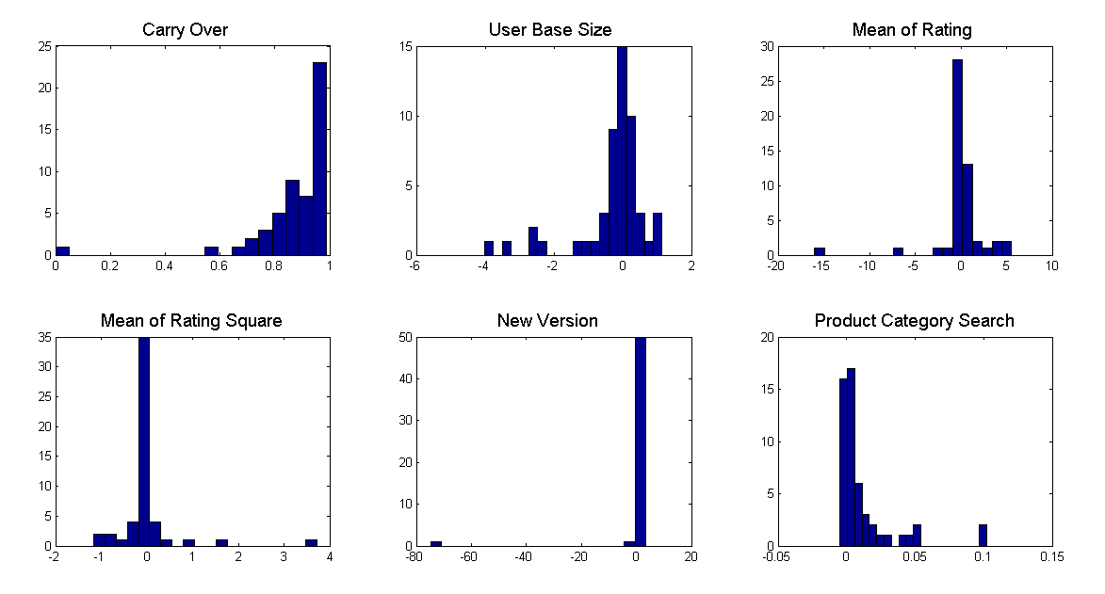
Parameters Distribution: Heterogeneity

Slide 20
Mean Elasticity parameter Estimate Across Products
 | Mean | SD | 2.5th Percent | 97.5th Percent
Carry Over | 0.878 | 0.158 | 0.835 | 0.921
User Base Size | -0.307 | 1.064 | -0.596 | -0.018
Mean of Rating | 0.047 | 2.866 | -0.732 | 0.826
Mean of Rating Square | 0.009 | 0.651 | -0.168 | 0.186
Version | 0.629 | 2.986 | -0.183 | 1.440
Product Category Search | 0.012 | 0.023 | 0.006 | 0.018
 | 0.109 | 0.267 | 0.036 | 0.181
Weekend Dummy | -39.799 | 0.000 | -39.799 | -39.798
 | 4.168 | 16.664 | -0.361 | 8.697

Slide 21
Mean parameter estimate in static versus dynamic models
 |  |  | Static Model | Without heterogeneity | Dynamic Model
 | Carry Over |  | 0.000 | 0.878 | 0.005
 | User Base Size |  | 1.123 | -0.307 | 0.170
 | Mean of Rating Valence |  | -1.155 | 0.047 | -0.238
 | Mean of Rating Square |  | 0.436 | 0.009 | -0.006
 | Product Category Search |  | 2.092 | 0.012 | 0.065
 | Version |  | 0.100 | 0.629 | -0.006
 | Vi |  | 19.223 | 0.109 | 422.024
 | Weekend Dummy( ) |  | -69.769 | -39.799 | 0.316
 | Wi |  | 7.481 | 4.168 | 7.731

Slide 22
Significance of Effects
 |  |  | Static Model | Dynamic Model
 | User Base Size |  | 41 | 25
 | Mean of Rating Valence |  | 43 | 30
 | Mean of Rating Square |  | 42 | 29
 | Product Category Search |  | 15 | 18
 | Version |  | 45 | 36
 | Vi |  | 52 | 52
 | Weekend Dummy |  | 52 | 52
 | Wi |  | 52 | 52

Slide 23
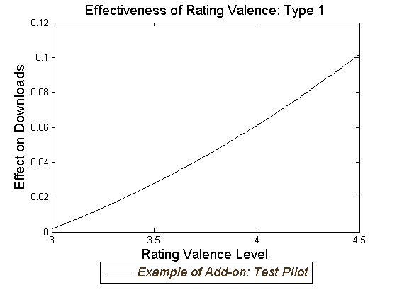
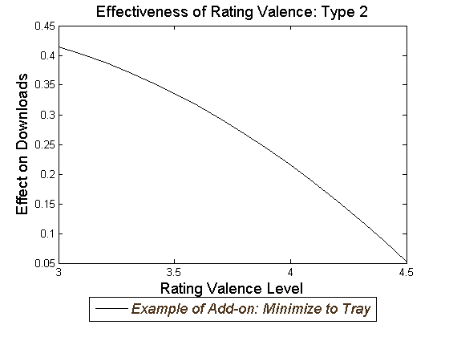
Individual analysis: average rating
Significant only for 9 out of 52 add-on Increasing return of Rating
Significant for 19 out of 52 add-ons

Slide 24
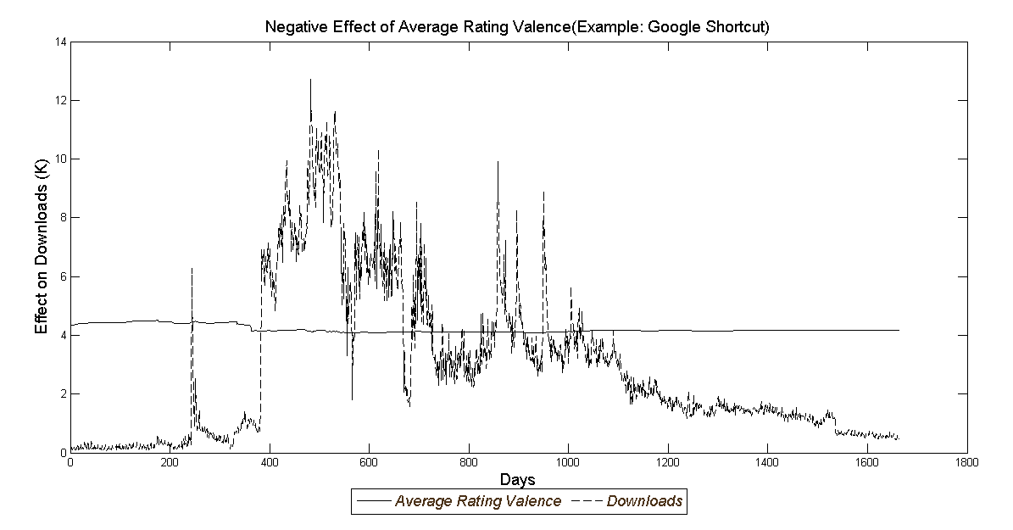
Explanation of Negative Effect of Average Rating Valence
Ignorance of negative rating and diffusion process

Slide 25
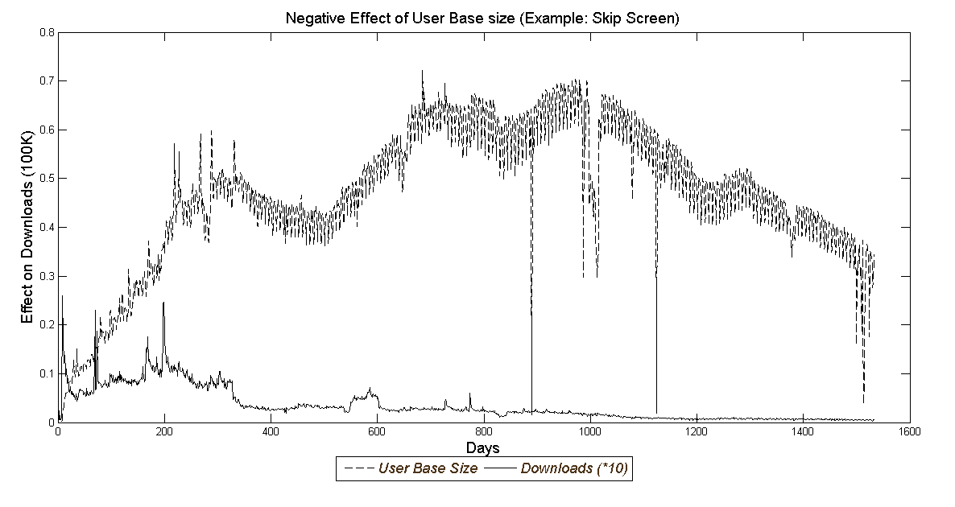
Two fold effect of user base size
Positive effect: Product usage as signal
Negative effect: Bass Model

Slide 26
Parameter Heterogeneity
 |  | Estimate | SD | 2.5 % | 97.5 %
Carry Over | Intercept | 0.345 | 0.239 | 0.11 | 0.89
 | Share of Windows | 0.631 | 0.272 | 0.01 | 0.91
User Base Size | Intercept | 0.306 | 0.268 | -0.14 | 0.75
 | Variance steady state | -0.333 | 0.166 | -0.62 | -0.07
Mean of Rating Valence | Intercept | 0.667 | 0.299 | 0.13 | 1.16
 | Author Team Size | -0.352 | 0.185 | -0.65 | -0.05
Mean of Rating Square | Intercept | -0.149 | 0.067 | -0.25 | -0.04
 | Author Team size | 0.090 | 0.043 | 0.02 | 0.16
New version | Intercept | 0.126 | 0.149 | -0.12 | 0.37
 | used with users (K) | 0.002 | 0.001 | 0.001 | 0.004
Product Category Search | Intercept | 0.005 | 0.008 | -0.01 | 0.02
 | collection follower (K) | 0.002 | 0.001 | -0.003 | 0.004
Weekend Dummy( ) | Intercept | -39.398 | 0.619 | -40.34 | -38.48
 | Photo music category | 0.000 | 0.041 | -0.07 | 0.06
M1 |  | 0.013 | 0.003 | 0.01 | 0.02
M2 |  | 0.636 | 0.181 | 0.38 | 0.96
M3 |  | 0.849 | 0.337 | 0.43 | 1.46
M4 |  | 0.052 | 0.020 | 0.03 | 0.09
M5 |  | 1.000 | 1.000 | 1.00 | 1.00
M6 |  | 0.002 | 0.000 | 0.00 | 0.00
M7 |  | 0.008 | 0.008 | 0.00 | 0.02

Slide 27
Finding’s summery
Product rating has dynamic, yet diverse, and increasing return effect on demand
Observational learning dynamically affects demand, more when there is uncertainty, and this effect is heterogeneous
Heterogeneity in carryover and effect of rating can be explained by market segment size and competition intensity

